Slide 1
B Cell Ontogenesis
Dr Oyaro

Slide 2
Learning objectives
Discover how lymphoid stem cells become B cells destined to make antibodies
Understand the importance of Ig gene rearrangement
Appreciate mechanisms leading to B-cell leukemias
Functions of B-cells

Slide 3
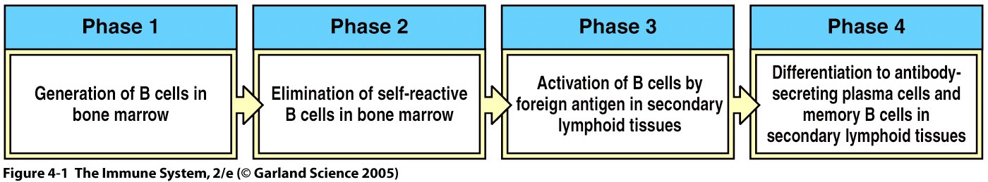
Phases of B-cell development
Tens of billions of B cells generated each day in the bone marrow; only 50% survive
Bone marrow: primary lymphoid tissue
Development means the cell surface expression of a unique B Cell Receptor (BCR), which is an Ig molecule (monomeric IgM and IgD)

Slide 4
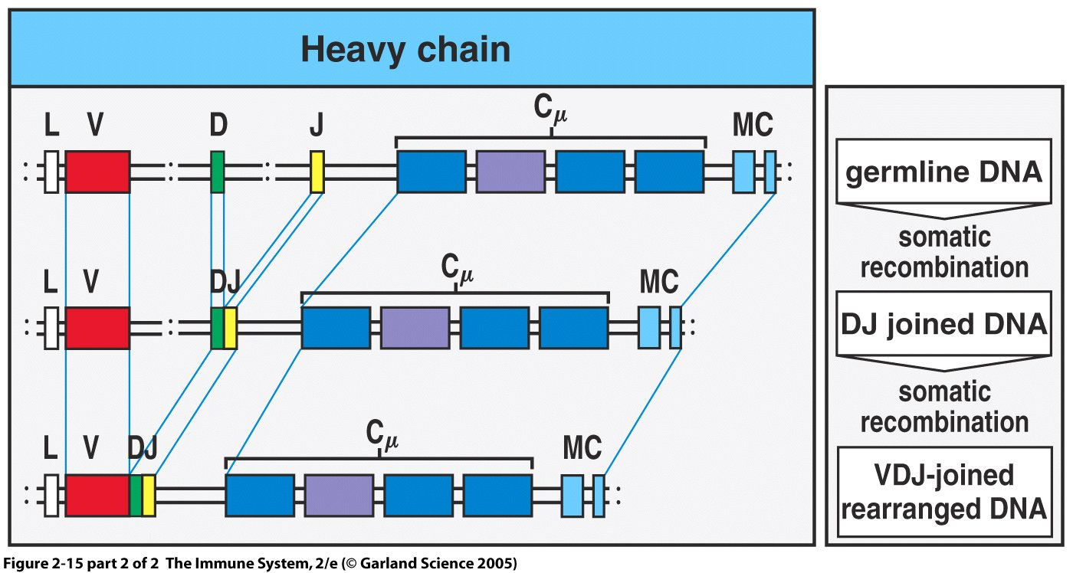
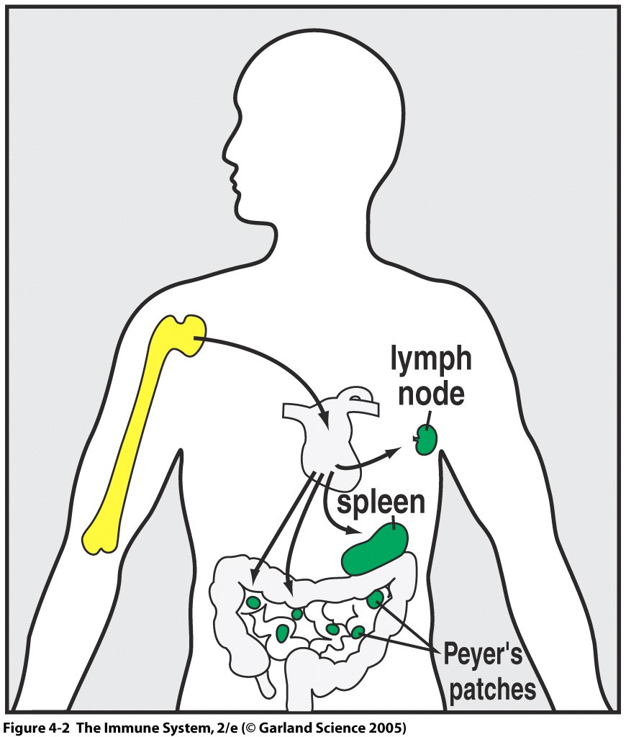
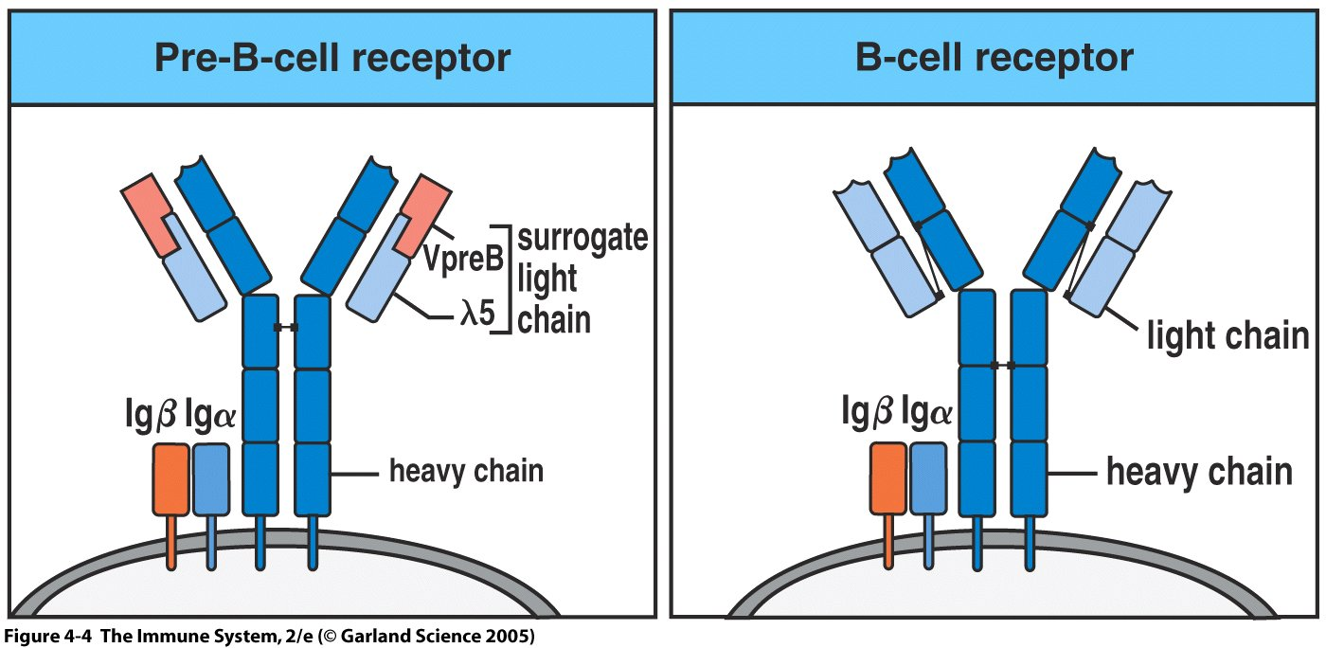
B cell receptor = μ + light chain
pre-B cell receptor = μ + surrogate light chain

Slide 5
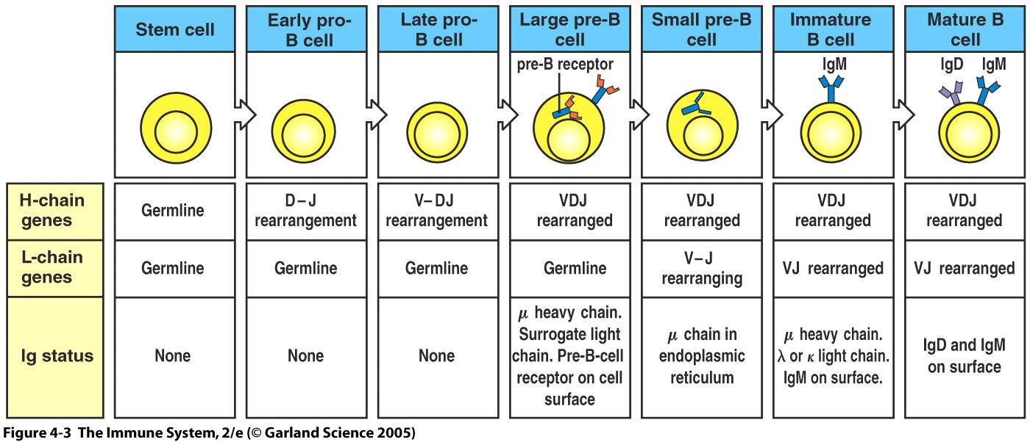
Stage 1: Immunoglobulin (Ig) Gene Rearrangement (No antigen)
1
2
3
4
Pre-B-cell receptor: initiates cell division resulting in 30-70 small pre-B cell clones (all have same heavy chain, but with potential to have different light chains)
Signal from pre-B-receptors halts HC gene rearrangement & sLC synthesis; cell proliferation to yield lots of small pre-B-cells; cell division stops and light chain gene rearrangement begins
Immature B cells selected for tolerance (prevents autoimmunity)
Tolerant immature and mature B cells enter periphery (immature cells mature in the spleen)
Naïve B cells (never seen antigen) circulate looking for foreign microbes

Slide 6
Igα and Igβ are Signaling Subunits of the B Cell Receptor (BCR; surface Ig molecule)
The Ig molecule (either pre-BCR or BCR) can not travel to the surface of the B cell without Igα and Igβ
The pre-BCR and BCR consist of an Ig molecule plus Igα and Igβ
Igα and IgΒ genes turned on at the pro-B-cells stage and remain on until cell becomes an antibody secreting plasma cell
Igα and Igβ send signals when receptors are engaged or ligated (bound antigen)

Slide 7
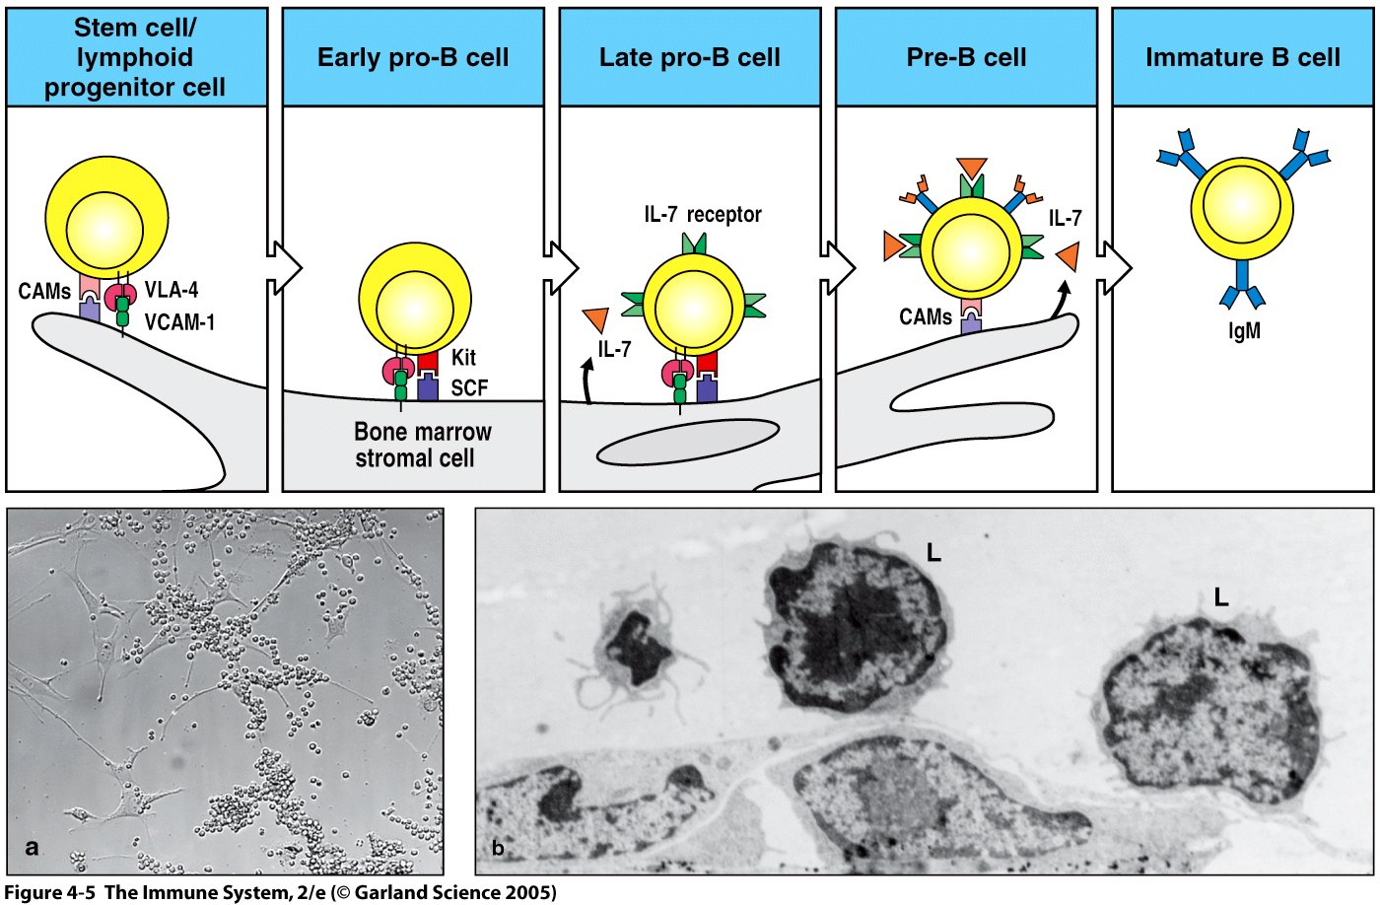
Bone Marrow Stromal Cells Direct B Cell Development
Adhesions molecules: CAMS (cellular adhesion molecules)
VLAs, VCAMs (Vascular lymphocyte adhesion molecules)
Signaling molecules: Kit (receptor); SCF (Stem cell factor - membrane bound growth factor) - stimulates growth and proliferation
IL-7 - stimules growth and proliferation

Slide 8
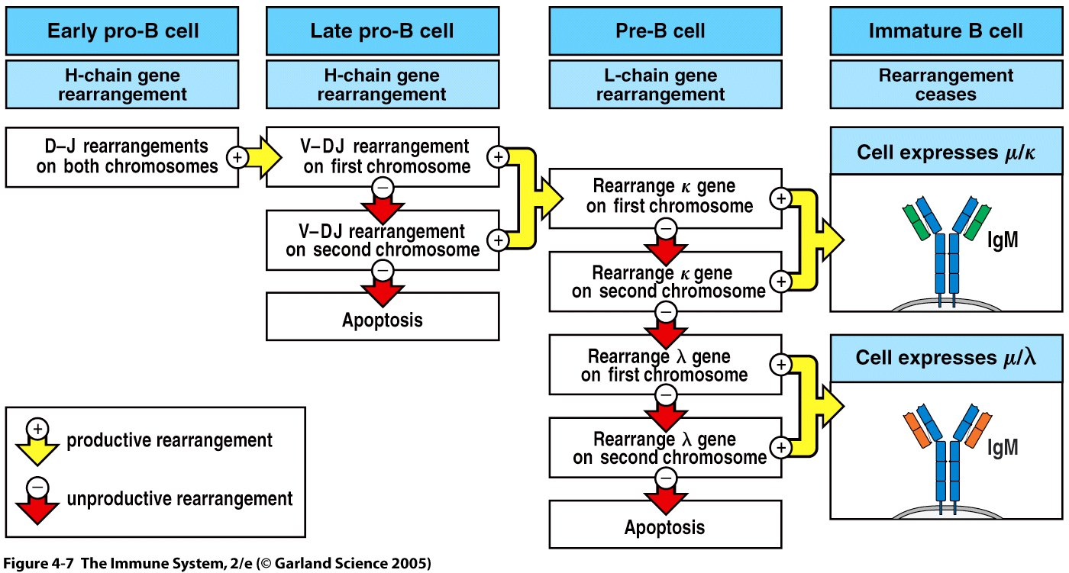
Productive Gene Rearrangement ----> Survival
Two copies of each heavy chain and each light chain loci
Most DJ rearrangements are successful (D can translate three reading frames)
VDJ rearrangement is consecutive; 50% success rate (remember: μ chain)
κ and λ chain rearrangement is 85% successful
Unproductive gene rearrangement results in apoptosis (programmed cell death)

Slide 9
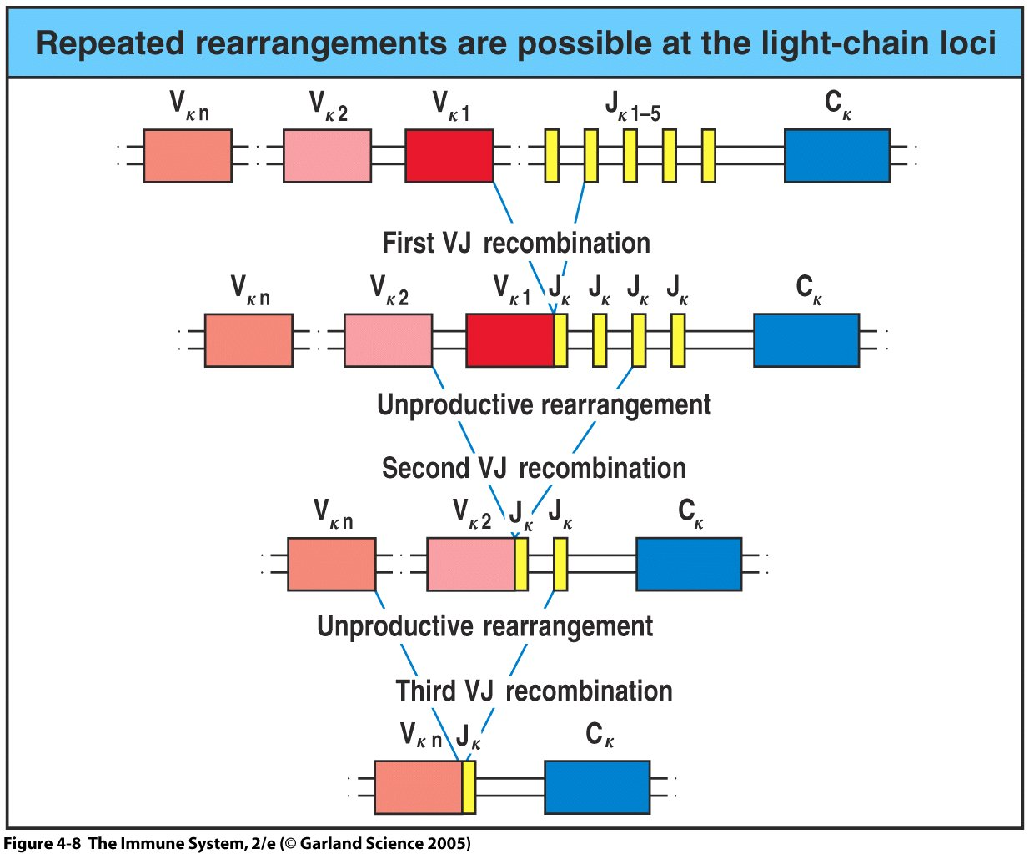
Light Chain has Several Chances to Rearrange
Large pre-B-cells undergo cell division before becoming resting small B cells; LC rearrangement
Starts with κ and goes until all possibilities have been tried
LC rearrangement, 85% successful
Overall success of Ig gene rearrangement is less than 50%

Slide 10
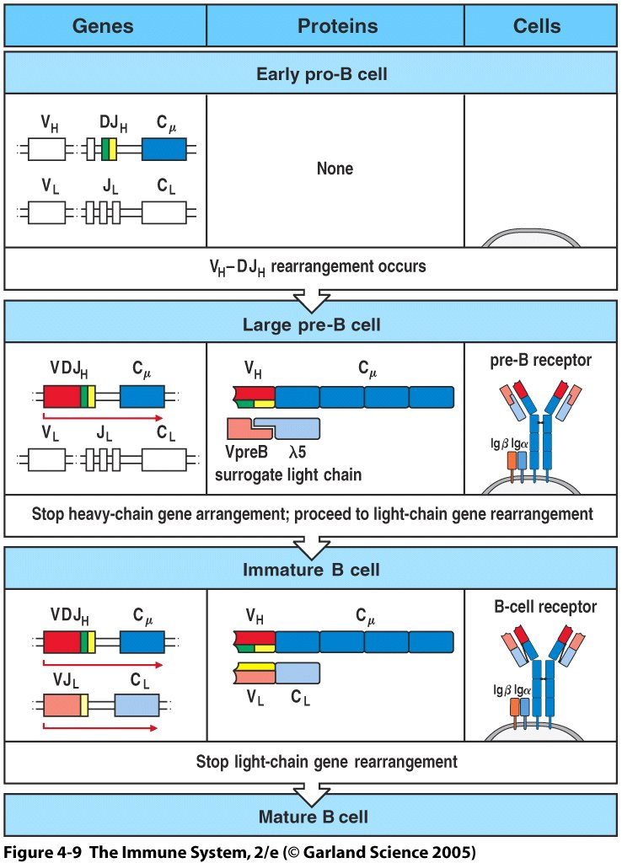
Ending Gene Rearrangement
Mechanism of ending gene rearrangment
Need to shut down rearrangement twice
Pre-BCR interacts with an unknown ligand to shut off heavy chain rearrangement
BCR initiate the shut off signal for light chain rearrangement
1
2

Slide 11
Regulating B Cell Development
Genes essential for gene recombination are turned on at selective stages of B cell development
Genes encoding RAG;
-turned on in Early pro-B cell and late pro-B cell (HC rearrangement)
-turned off in Large pre-B cell (to allow proliferation)
-turned back on in Small-pre-B cell (LC rearrangement)
3. Terminal deoxynucleotidyl transferase (TdT)
-responsible for diversity (N nucleotides)
-turned on in pro-B cells, silent in small pre-B cells
Genes encoding Igα and Igβ
-turned on in pro-B cells and remain on
5. Bruton’s tyrosine kinase (Btk)
-signaling molecule whose deficiency prevent B cell development

Slide 12
X-linked Agammaglobulinemia
Igα and Igβ signal to a signaling molecule: BTK
Btk needed to signal B cell to develop
Reduced number of pre-B cells in bone marrow, lack of mature B cells,
Normal thymus and normal number of T cells
Recessive, X-linked
Patients lacking Btk (mostly boys) have B cell development blocked at the pre-B-cell stage and therefore have no circulating antibodies
Suffer from X-linked Agammaglobulinemia
Recurring infections: Haemophilus influenzae; Streptococcus pneumoniae, Streptococcus pyrogenes; Staphylococcus aureus
Treatment: antibiotics and infusion of antibodies (i.e passive immunity)

Slide 13
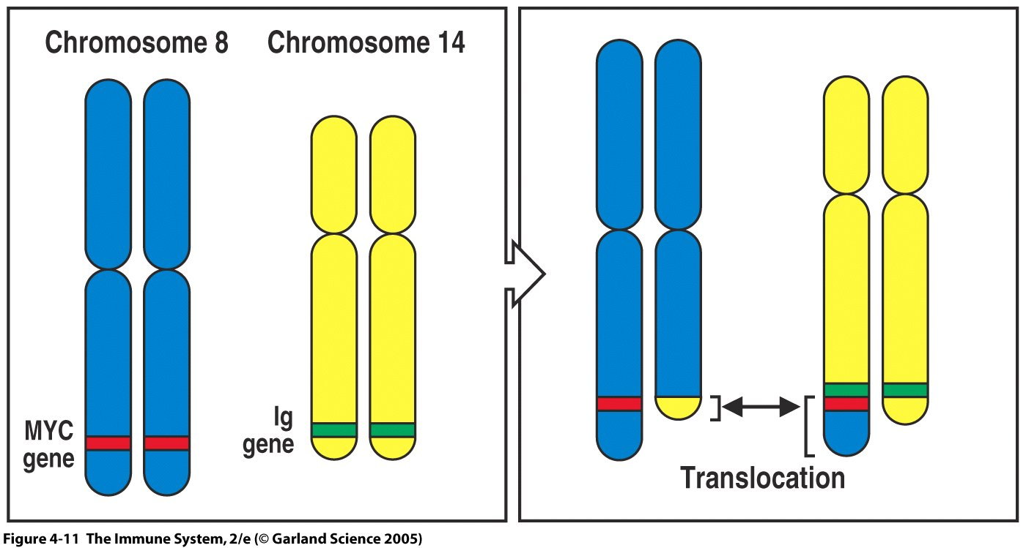
Formation of B Cell Tumors (Leukemias & Lymphomas)
High transcriptional and splicing activity during B cell gene rearrangement
Mistakes made that can result in deregulated cell growth leading to leukemia
Ig gene segment is mistakenly joined to a gene regulating cell growth
  -translocation: gene on one chromosome joined to a gene on a different chromosome
  -B cell tumors: Burkitt’s lymphoma; Ig gene segment mistakenly fused to a gene called MYC that regulates the cell cycle; along with additional mutation(s) leads to Burkitt’s lymphoma

Slide 14
CD5⁺ B Cells (B-1 Cells)
Arise early in embryonic development
Express CD5 on surface
No surface IgD; restricted BCRs; Abs to bacterial polysaccharides
Predominate in pleural and peritoneal cavities
Capacity for self-renewal
Most B cell tumors causing chronic lymphocytic leukemia (CLL) are transformed B-1 cells (express CD5 on surface)
Treatment: bone marrow transplant

Slide 15
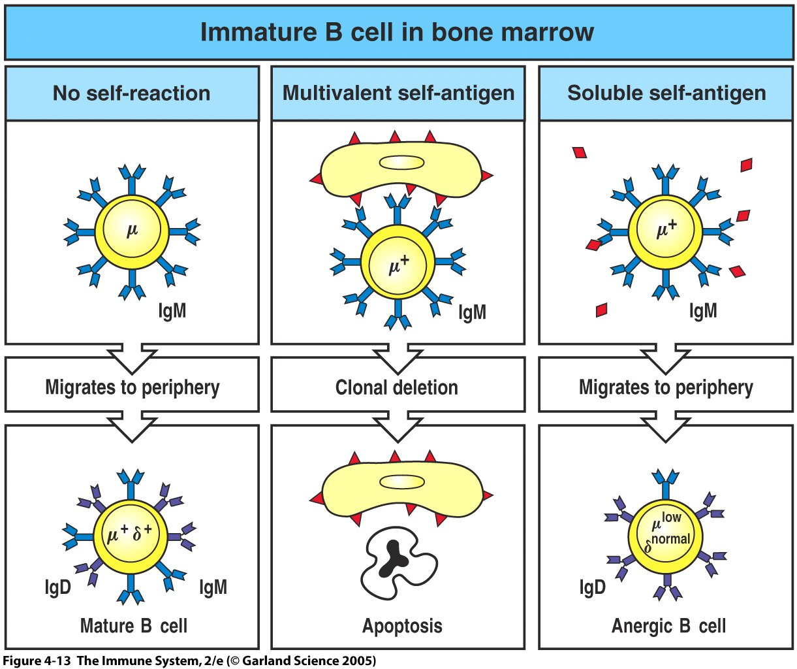
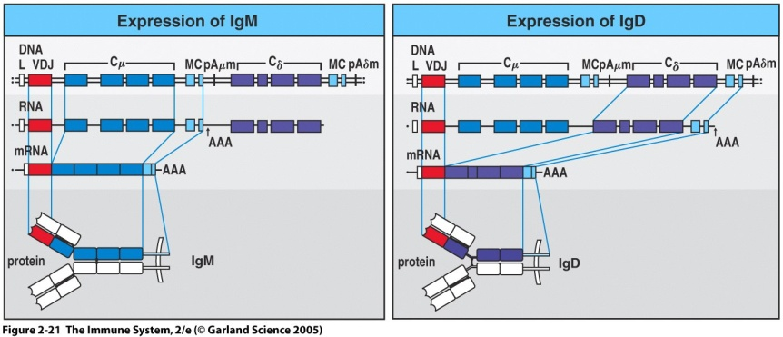
Alteration, Elimination, or Inactivation (Anergy) of Self-reactive B-cells
Who: immature B cells (sIgM)
Where: bone marrow (mostly)
How: signals sent by self Ags
-multivalent self-antigen change BCR (new LC) or DIE
-mechanism: signal sent by crosslinked BCRs
-soluble self-antigen (BM or periphery)
mature, migrate, but inactive (anergic)
-mechanism: no crosslinking of
BCRs; IgM (mostly in cytoplasm),
IgD on surface, but can’t signal

Slide 16
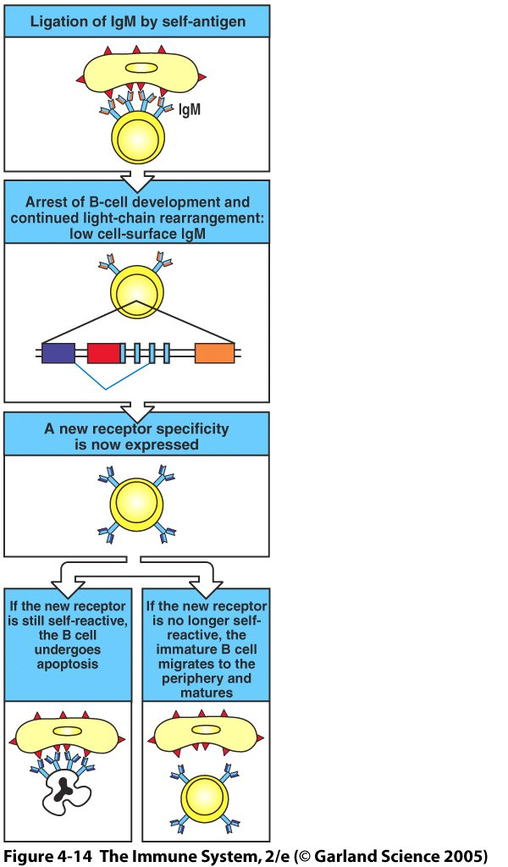
Self-reactive B Cells Get Another Chance
Receptor Editing (new LC, new BCR specificity)
-BCR “ligation” by multivalent Ags (MHC, crosslinks BCRs)
-stops development: RAG genes active; LC rearrangement
-new LC generated, synthesis of old LC stops
-if not self-reactive, cell migrates to periphery
-if self-reactive can continue until J segments are exhausted
-if still fails; apoptosis, which results in clonal deletion
-apoptotic B-cells phagocytosed by macrophages
-clonal deletion occurs in bone marrow OR right after the immature B cells enters the circulation
-55 billion B cells die each day: rearrangement fails (not productive; or autoreactive

Slide 17
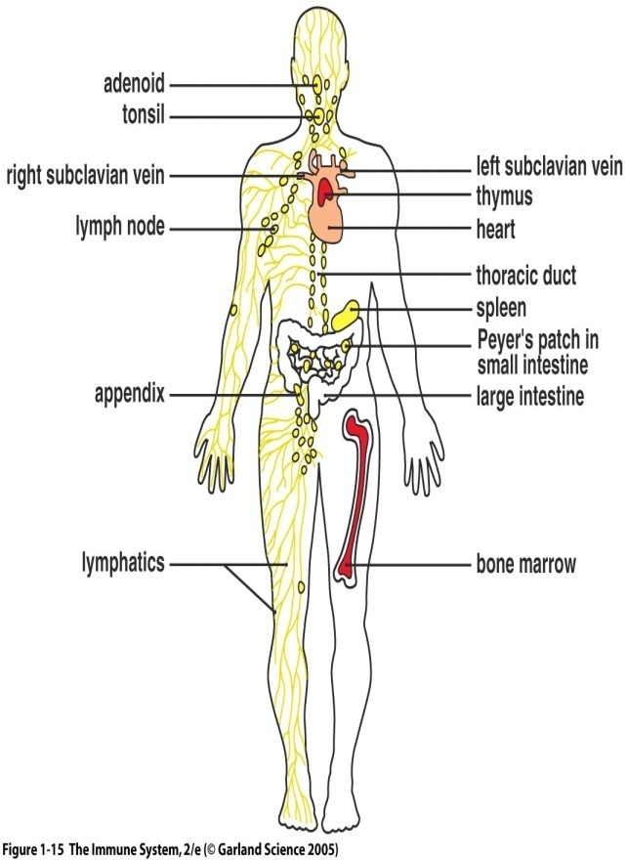
Naïve B Cells: Life in the Circulation
Travel Throughout Secondary Lymphoid Tissue (SLT)
-spleen, lymph nodes, MALT, GALT
-SLT: hang out in primary lymphoid follicles
-spleen: enter via blood
-lymph nodes: enter via lymphatic system
-primary lymphoid follicles contain follicular dendritic cells
- follicular dendritic cells: not APCs, not hematopoietic
-GALT (Peyer’s Patches), tonsils, appendix; committed to
IgA synthesis

Slide 18
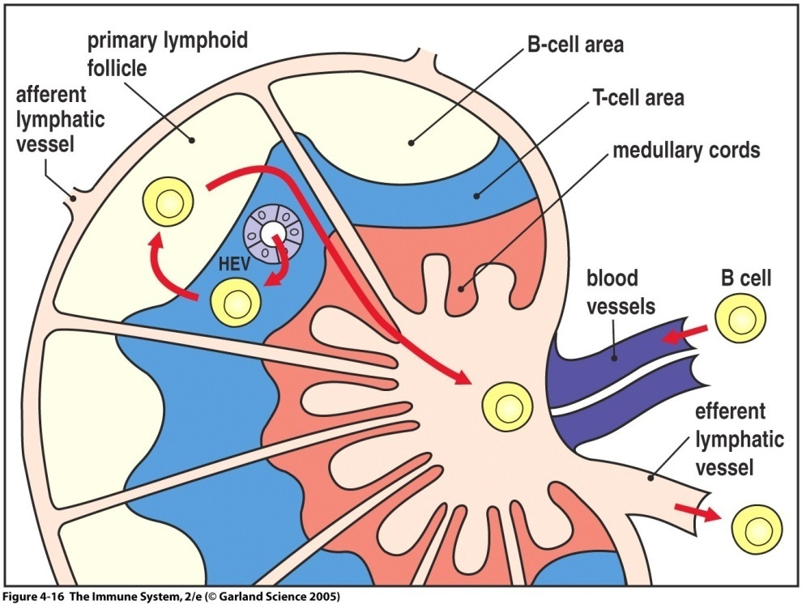
Mature, Naïve B Cells in Lymph Nodes
Passage Through SLT (eg. Lymph Nodes)
-enter T cell area from blood through HEV (high endothelial venules)
-no antigen, migrate to primary follicle
-receive signal to survive (FDCs)
-exit through efferent lymphatic vessel
-antigen, stay in T cell area and present
antigenic peptides to T cells
-GALT (Peyers Patches), tonsils, appendix: specialized for IgA
Competition for Survival Signals
-too many B cells, not enough FDCs to provide survival signals
-naïve B cells die within weeks in absence of antigen
Anergic B cells
-stuck in T cells area and prevented from entering the primary lymphoid follicle, fail to receive survival signals and DIE

Slide 19
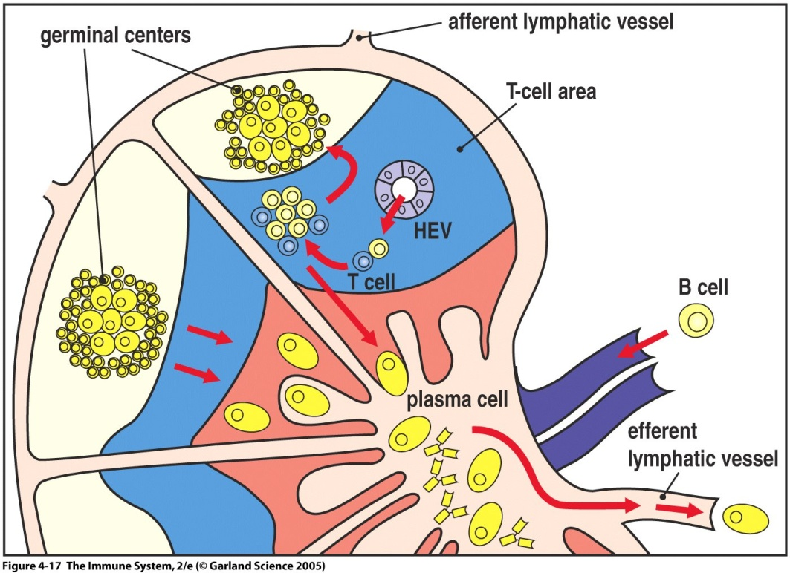
Big Moment: mature B Cells encounter antigen
Activation of B cells in Secondary Lymphoid Tissue (SLT)
- engulf bacteria in SLT
- detained in T cell area of SLT by binding to T cells and receiving “HELP”; T_{H2}/T_{HC} (CD4⁺)
- Help results in B cell proliferation and differentiation
-some activated B cells differentiate immediately into plasma cells secreting antibody (live only 4 weeks, no sIgM)
-others migrate to primary lymphoid follicles to undergo isotype switching and hypersomatic mutation (affinity maturation)

Slide 20
Big Moment: mature B Cells encounter antigen
Activation of B cells in Secondary Lymphoid Tissue (SLT)
-migration to primary lymphoid follicles results in generation of secondary lymphoid follicles containing germinal centers (GCs)
-centroblasts (large, proliferating)
-centrocytes (small, nondividing)
-undergone isotype switching
-undergone somatic hypermutation (high accumulation of mutations at V region of the centroblast stage of B-cell differentiation)
-centrocytes selected for high affinity BCRs (affinity maturation)
-lymphoblasts leave lymph nodes and migrate (other SLT) and bone marrow; differentiate into plasma cells
-memory B cells (high affinity, sIgG, sIgA, sIgE)

Slide 21
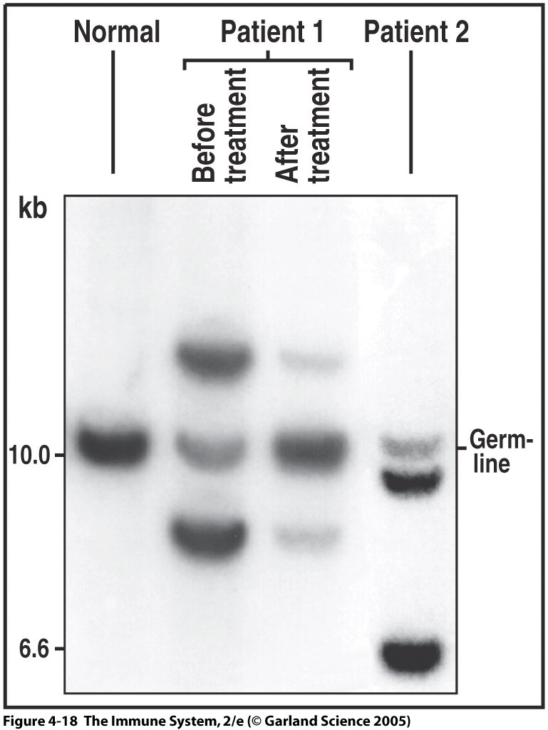
B Cell Tumors Arise at Different Stages of B Cell Development
Tumor Represents the Uncontrolled Growth of a Single Cell
-illustrated by B cell tumors; all have identical
rearranged Ig genes (originated from single cell)
-individual patient tumors are different
-follicular center cell lymphoma (naïve B cells;
grow in lymphoid follicles)
-myelomas (plasma cells; grow in bone marrow)
-Hodgkin’s disease (germinal center B cells)
-somatic mutations of tumor cells; no BCR
-stimulate non malignant T cell growth
-dendritic morphology
All have same rearranged Ig DNA

Slide 22
Functions of B cells
What are they?
Interaction with antigens through BCRs
Present antigenic peptides to T cells
Humoral immunity against external Ags
Opsonization (Ab bound to cognate Ag)

Slide 23
Summary
B cell originate from lymphoid progenitor stem cells and develop in the bone marrow thoughout life
Consecutive gene rearrangements of Ig genes results in the expression of a unique BCR (Ig molecule with H and L chains)
Several loci (2 HC; 4LC) to counter unproductive rearrangements
μHC rearranges first and this must be productive to continue
-forms pre-BCR (rearranged μHC and surrogate LC); ligation on cell surface halts HC gene rearrangement
5. LC rearrangement following proliferation of large pre-B cells
-4 loci; several attempts at each loci (85% success rate)
-productive light chain rearrangement halts further rearrangement
6. B cell repertoire is diverse (10¹¹)
7. Mistakes cause B-cell leukemias and lymphomas

